Slide 1
England's dwelling stock
Emrys duclos
Tiffany Tran-Heinerich

Slide 2
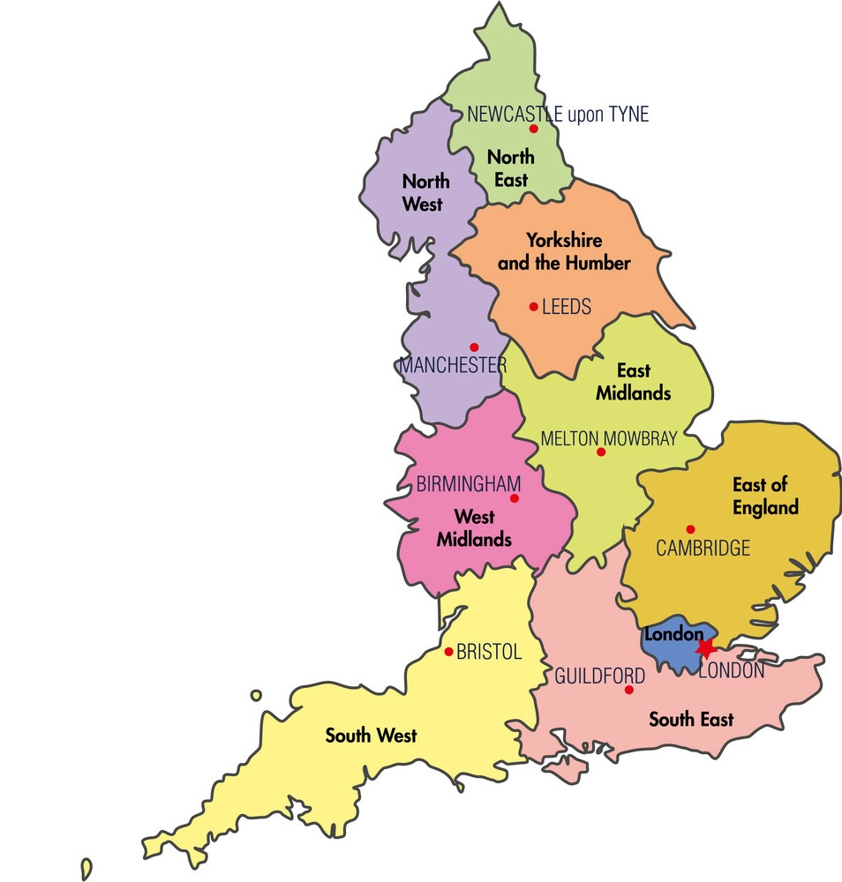
Agenda
Contextualization
Current status of dwelling stock
Energy efficiency
Modelling: historic dwelling stock
Modelling: future projections

Slide 3
Context
Population
And Legislation

Slide 4
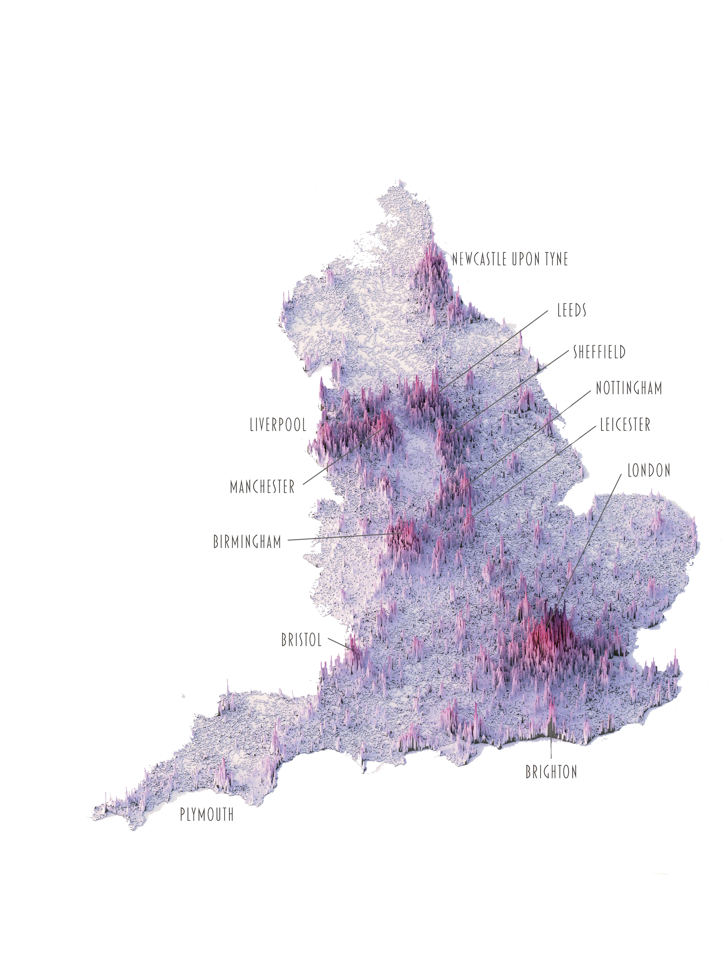
Context
Total pop: ca. 56 million
London pop: ca. 9 million
25 million dwellings
England => part of UK
=> datasets are not always clear

Slide 5
Building regulations in the uk (England+Wales)
The Building Act 1984 is giving the big frame for construction process, design and specifications.
The latest updates concern:
"Security" (2015)
"High Speed Broadband Infrastructure" (2017)
"Overheating" (2022)
The Climate Change and Sustainable Energy Act 2006 adds new regulations regarding energy.
The goal is to boost the number of heat and electricity microgeneration
Wind turbines
Ground source heat pumps
Solar electricity

Slide 6
Current status of dwelling stock
Stock evolution
Occupancy
Vacancy
Decency

Slide 7
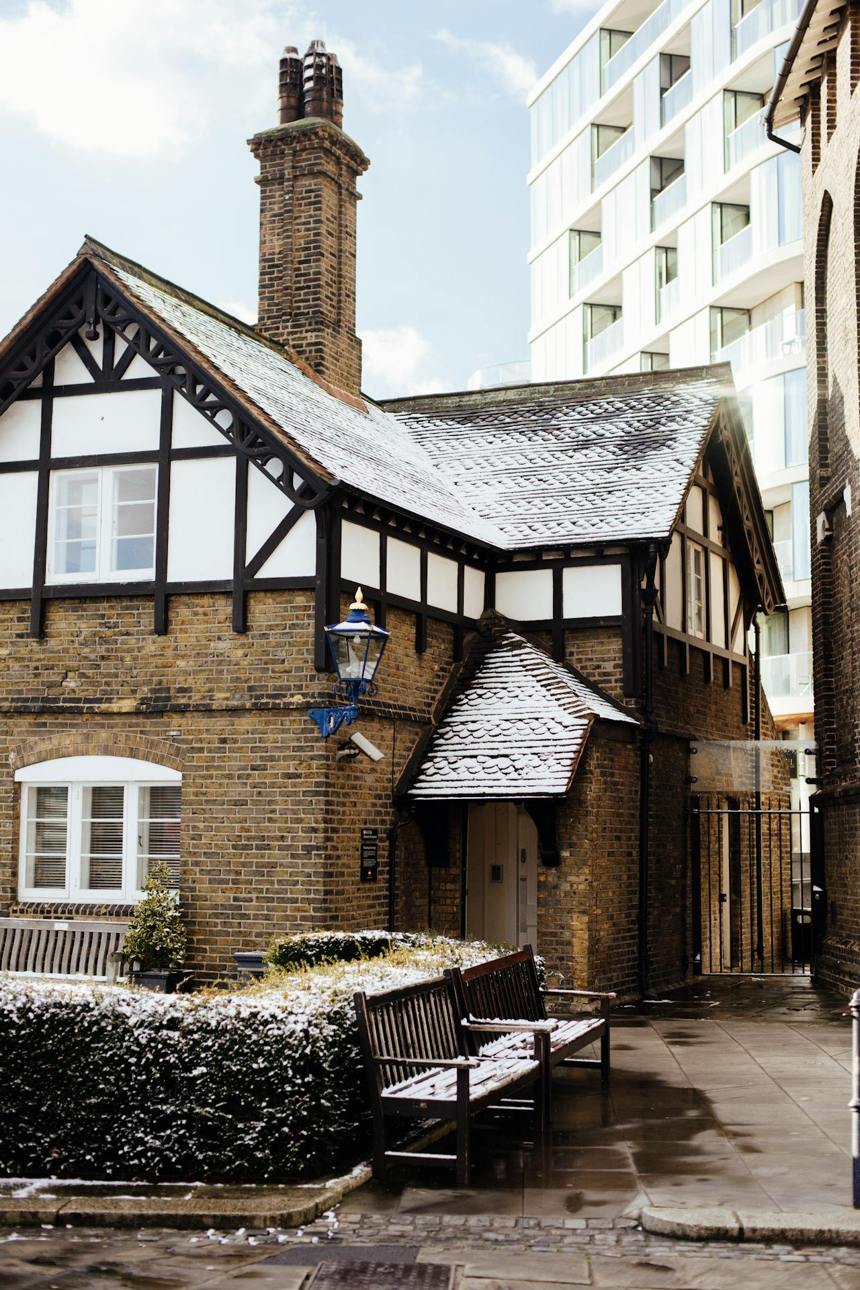
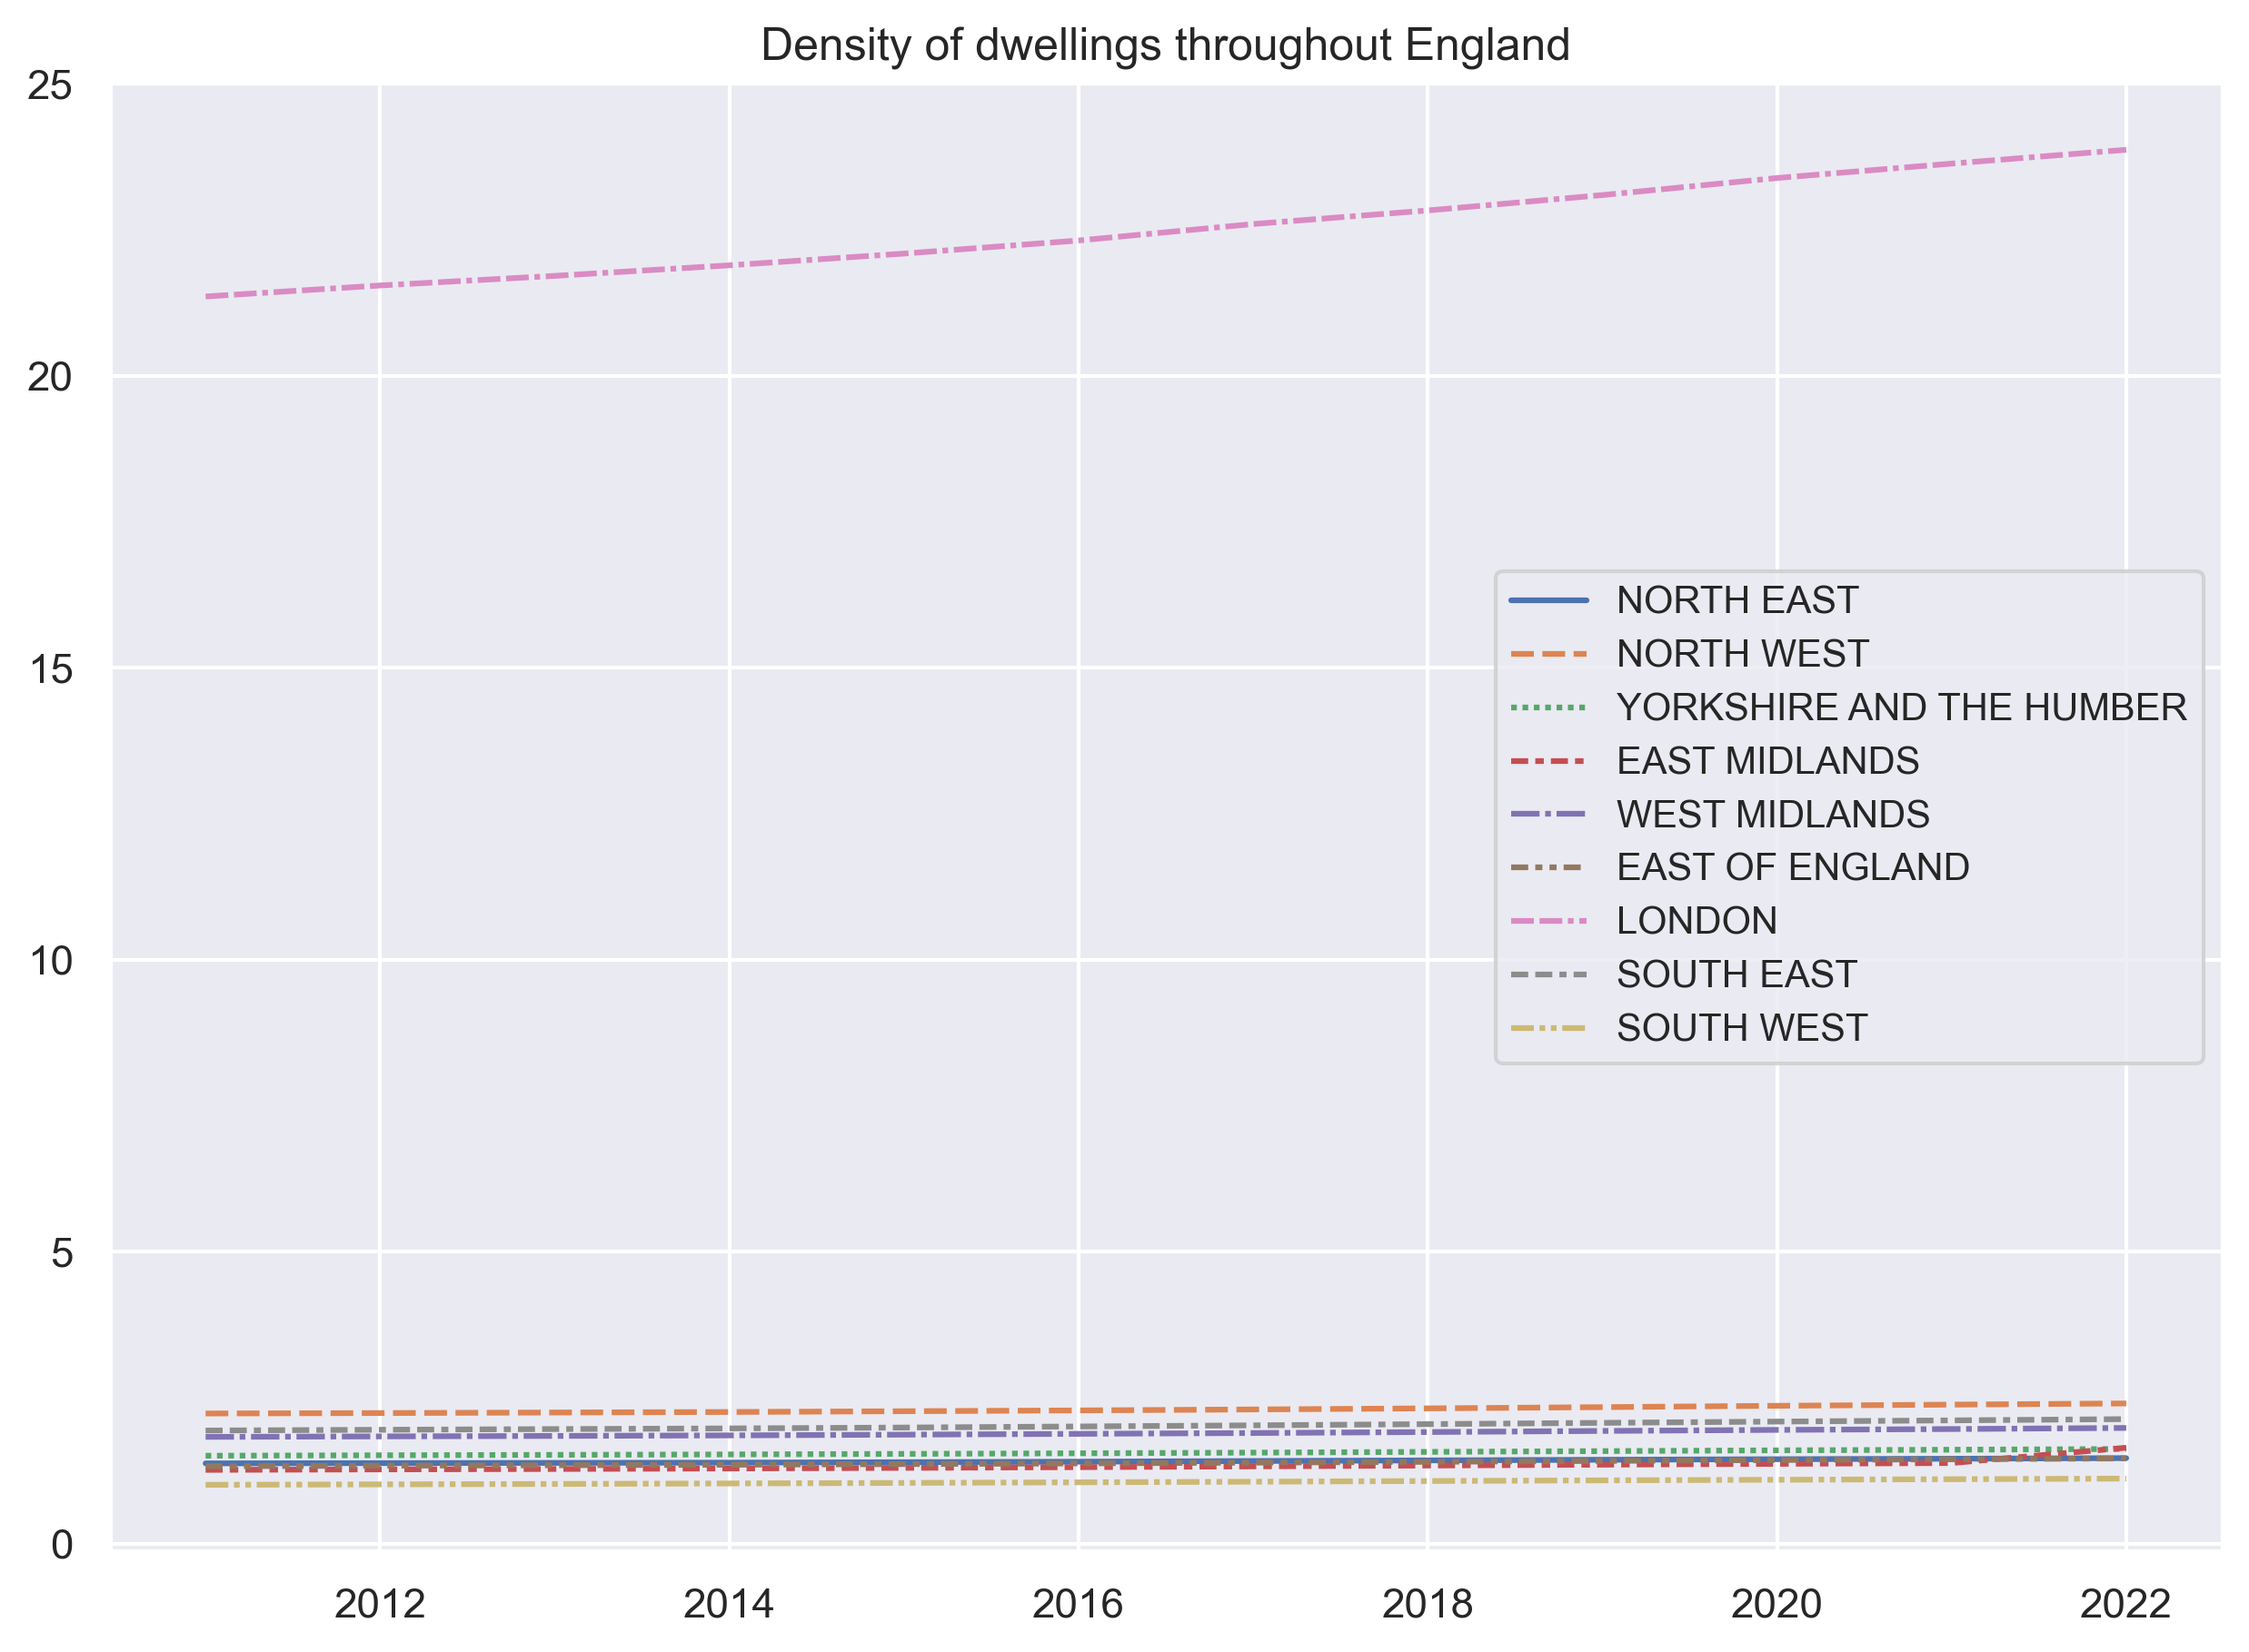

Slide 8
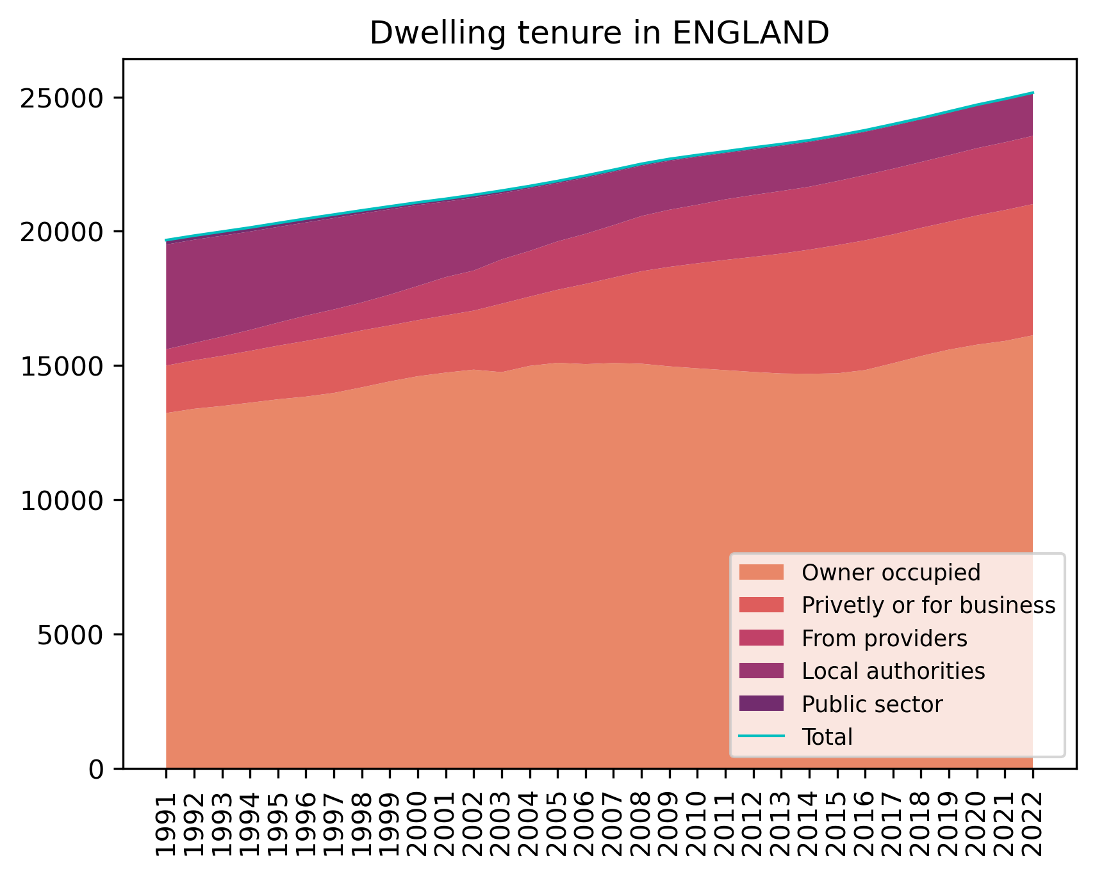

Slide 9
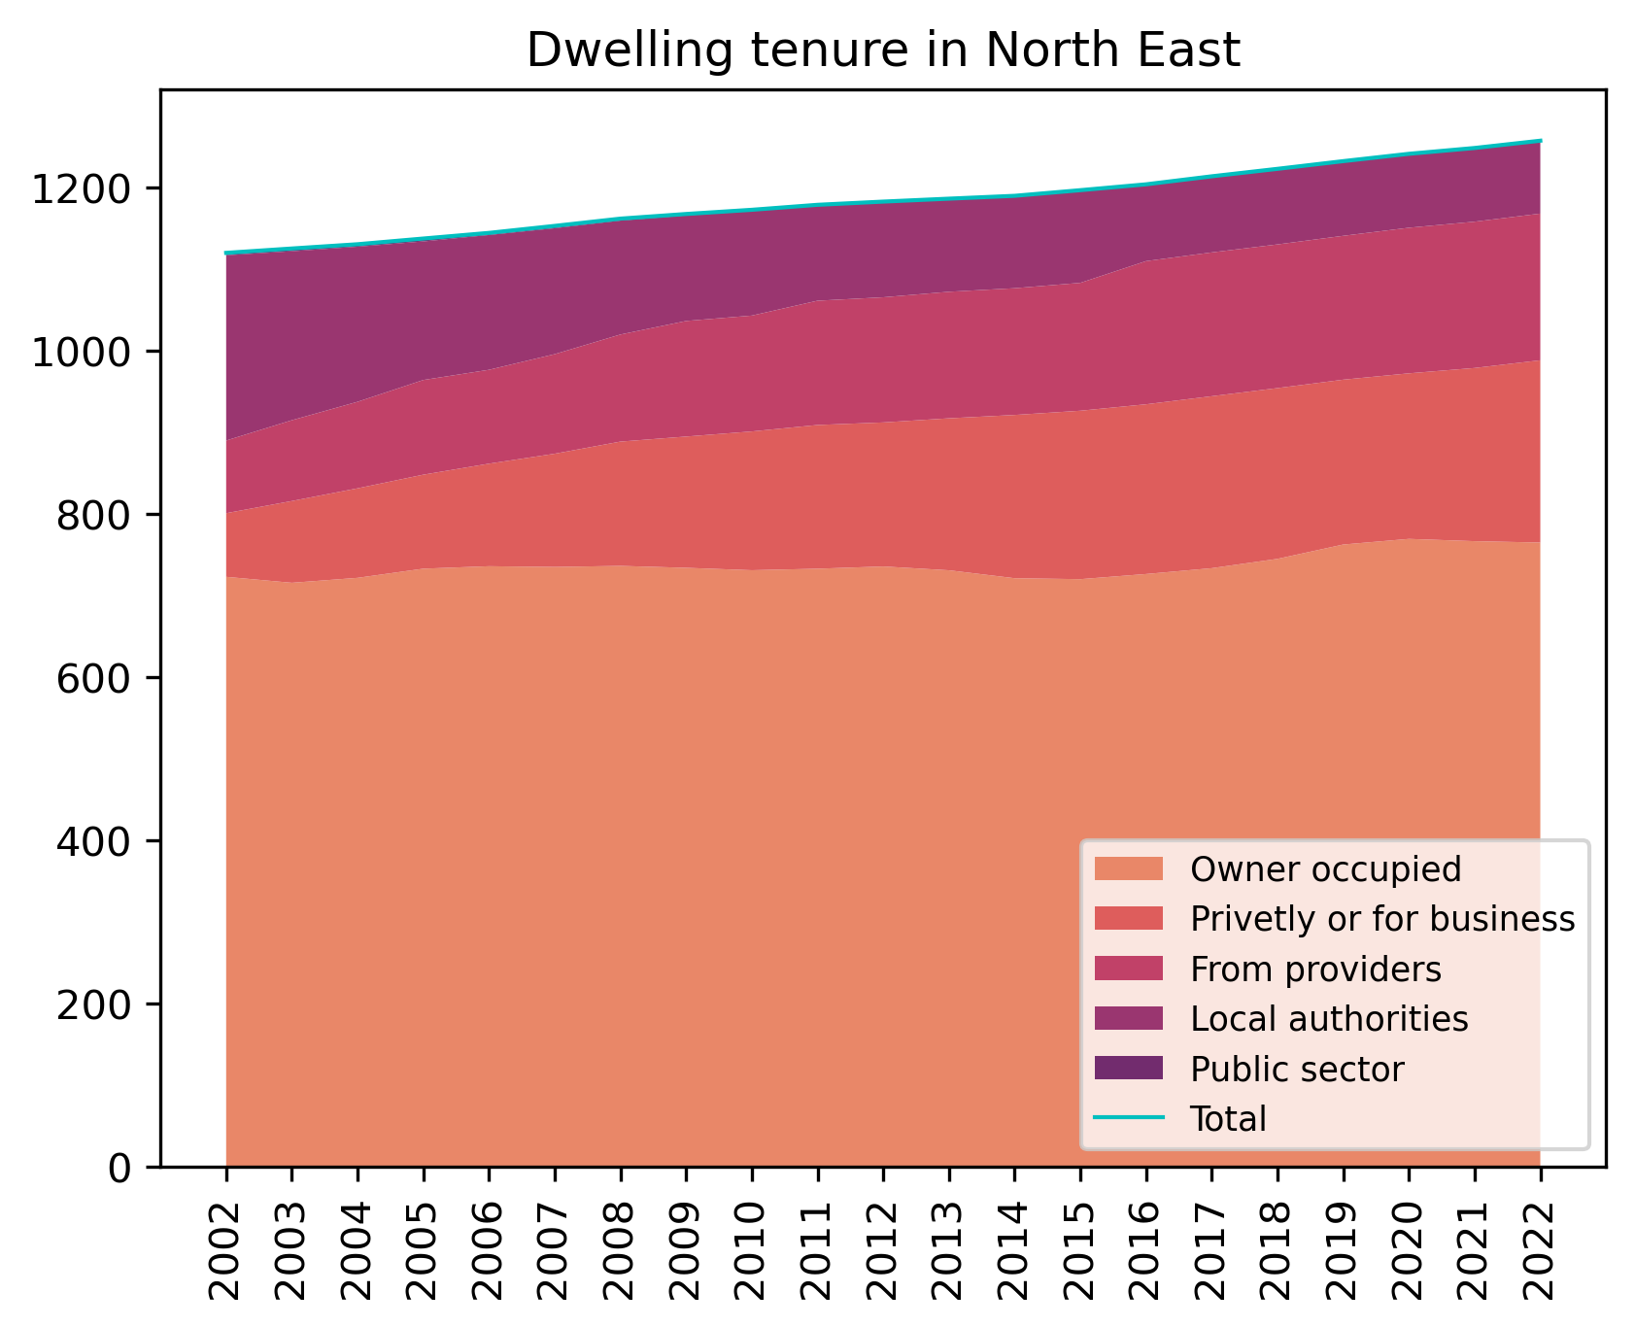
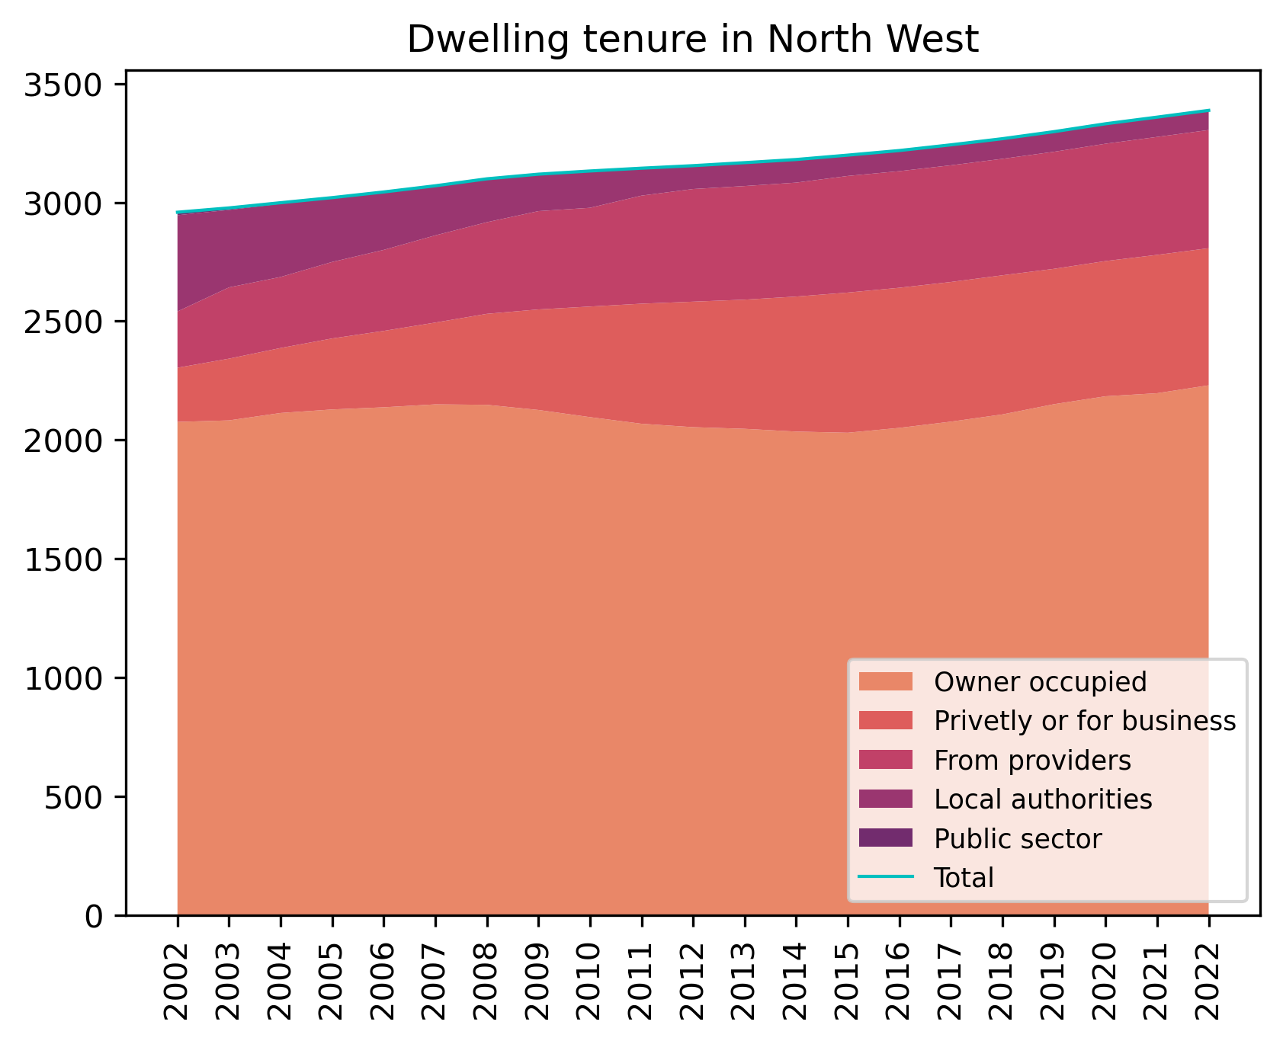
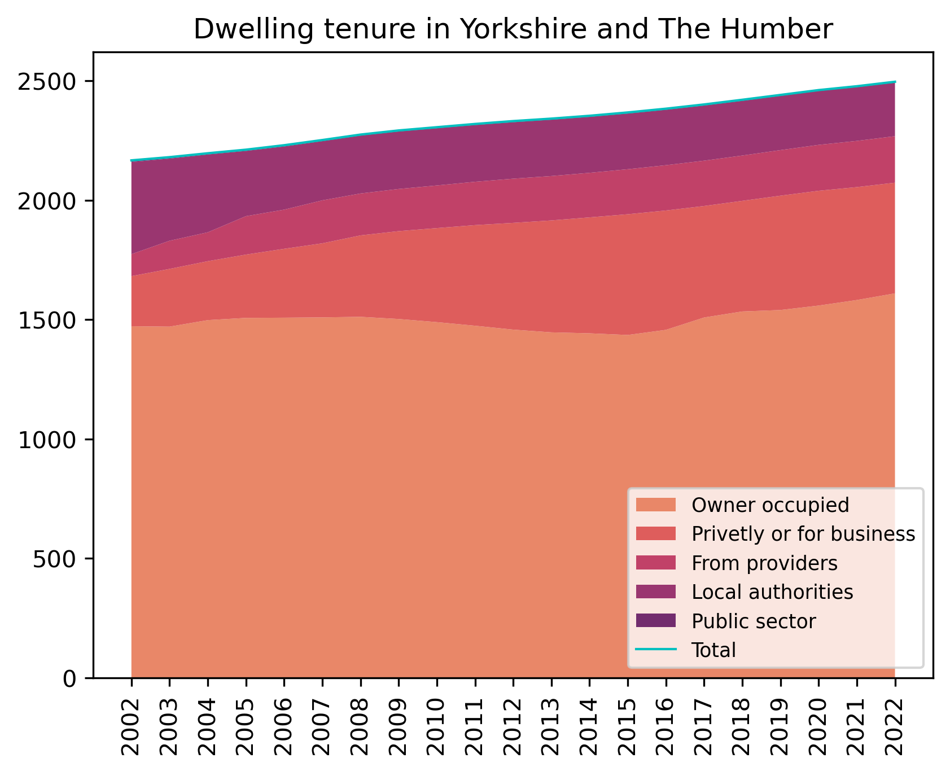
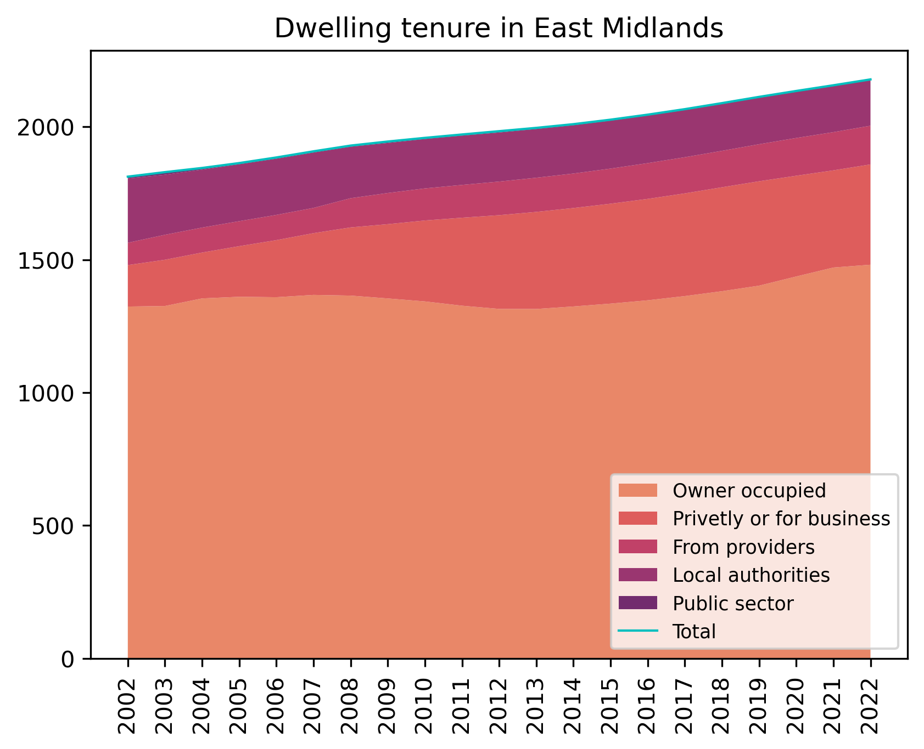


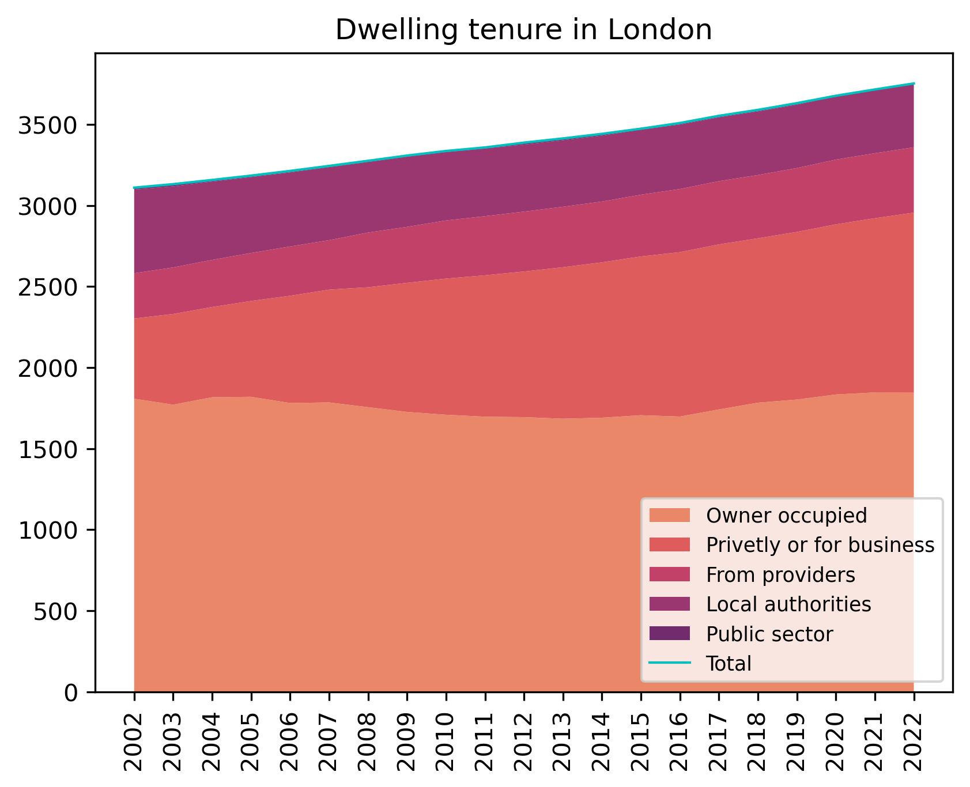
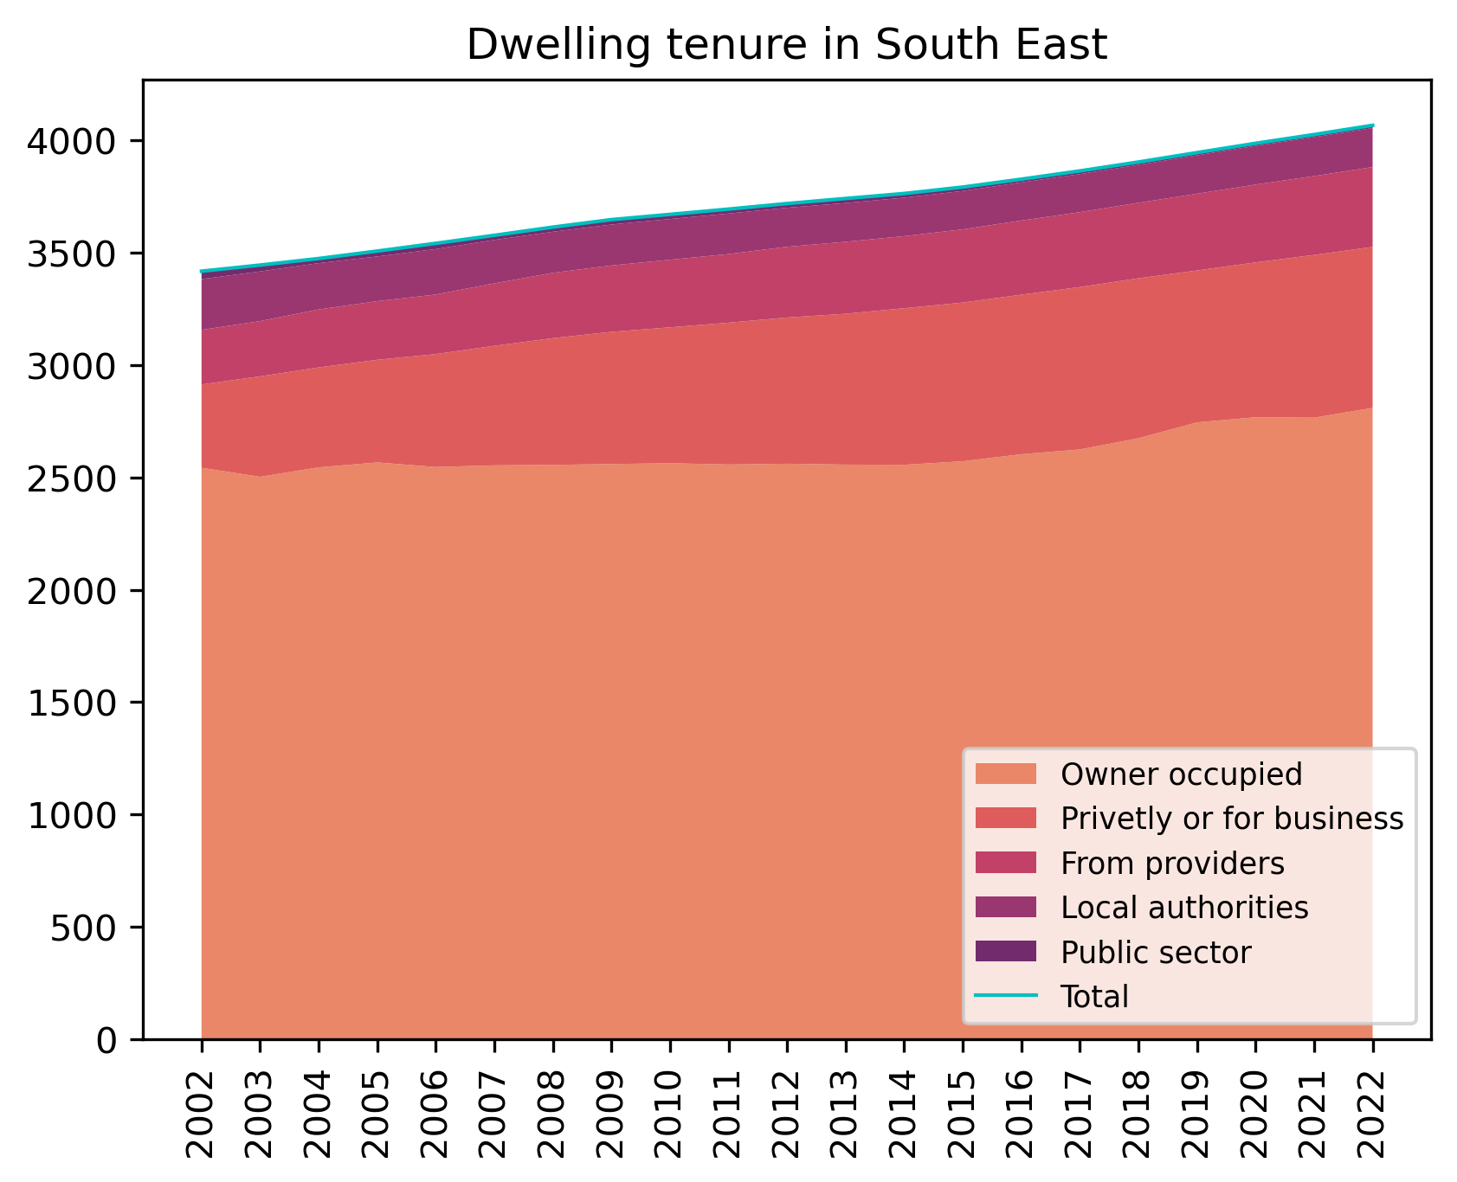

Dwelling by tenure, by region
[ thousands of dwellings ]

Slide 10
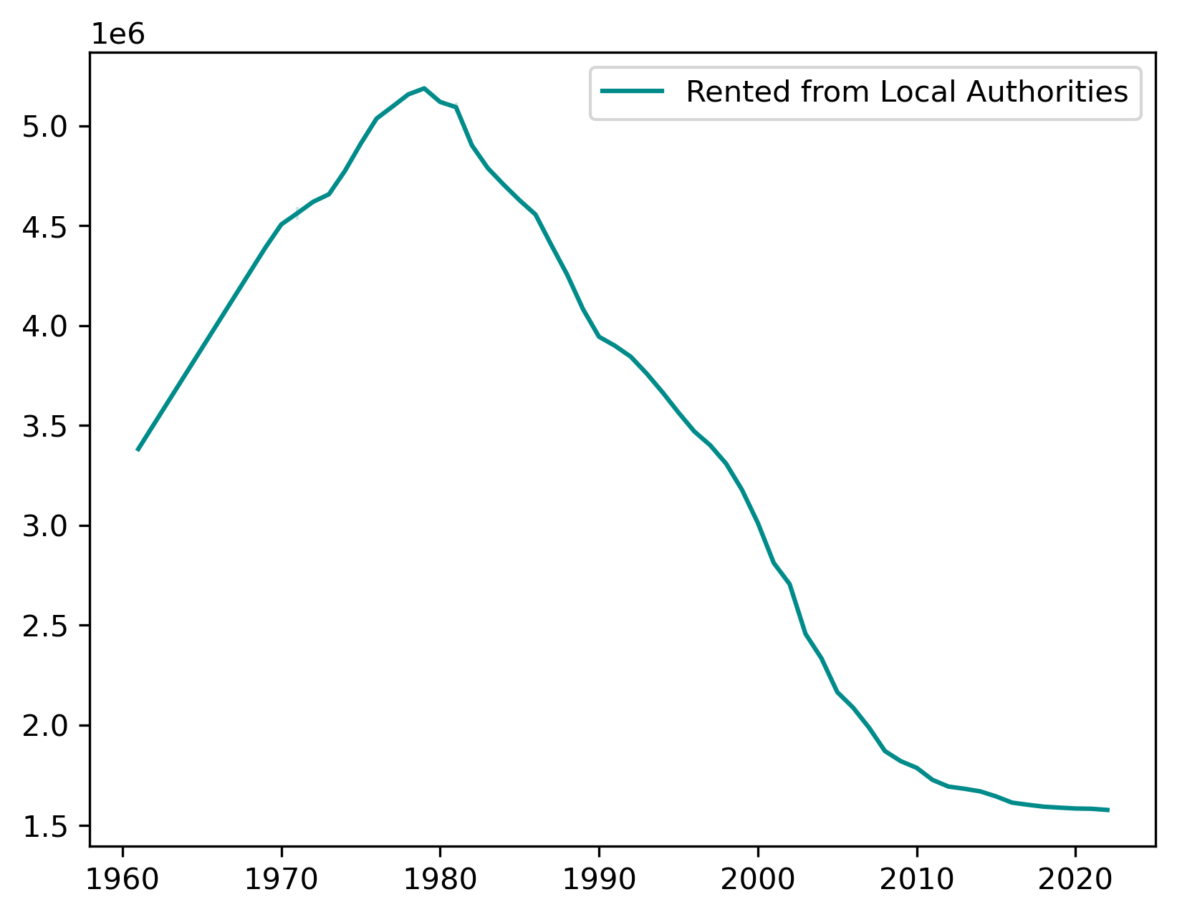
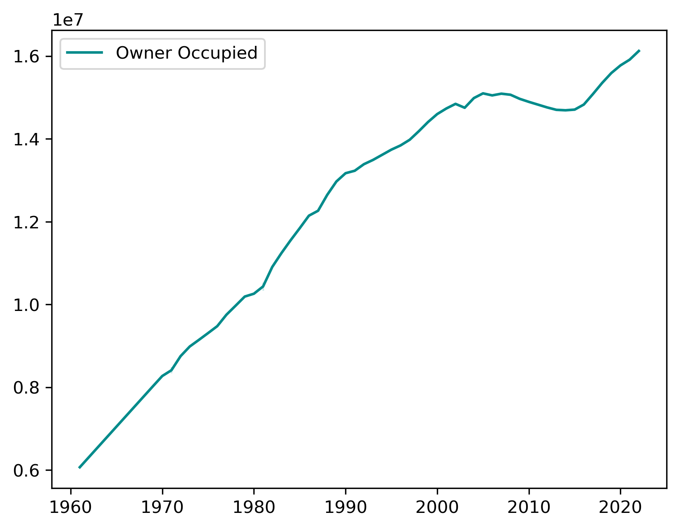
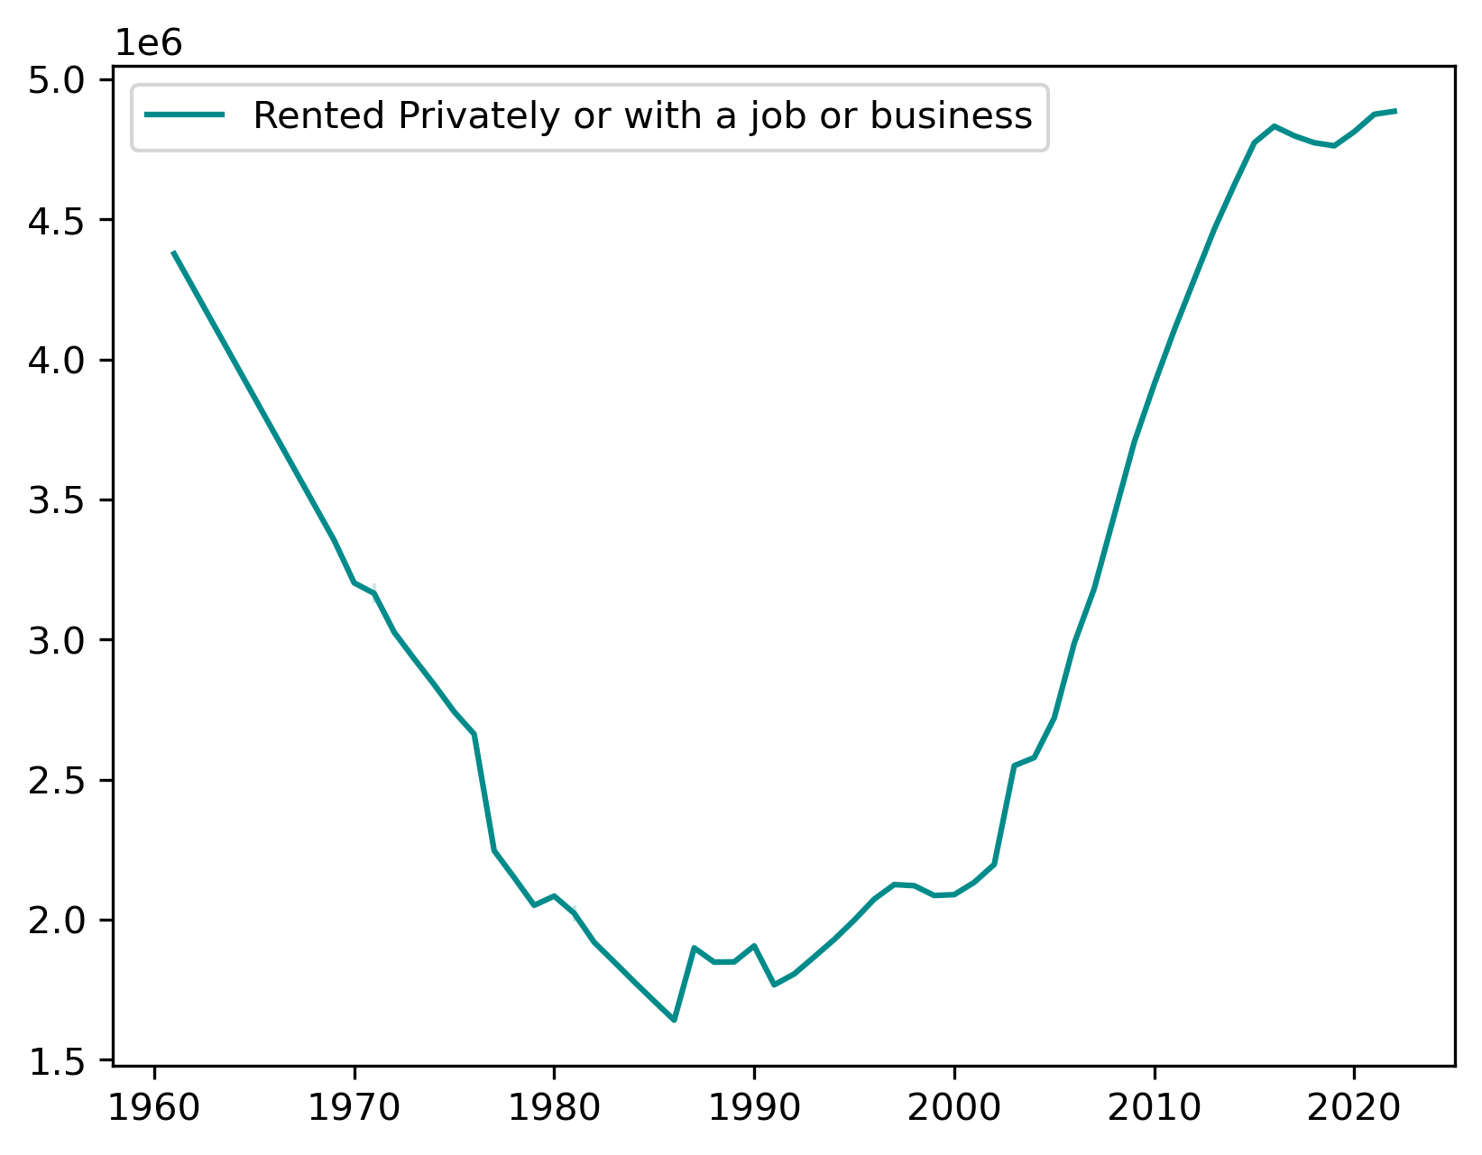
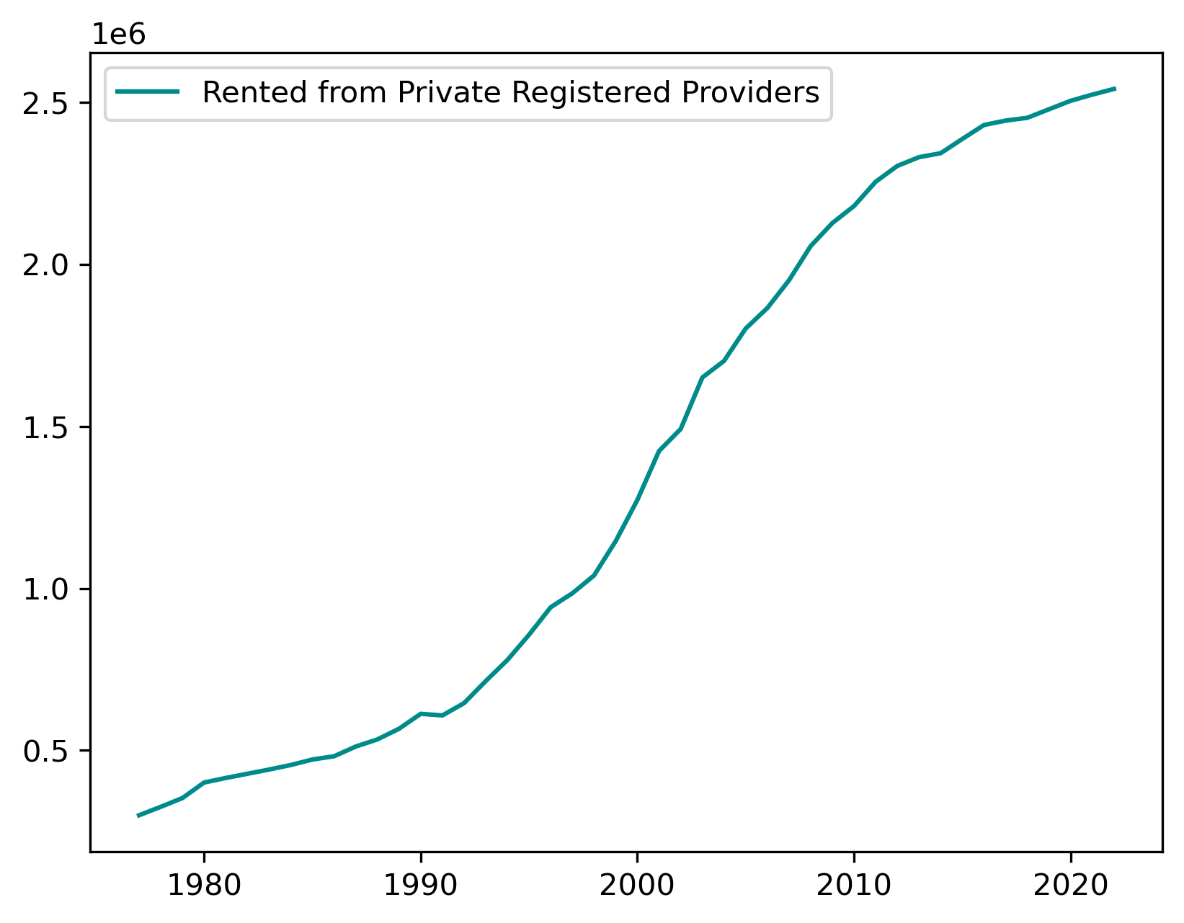
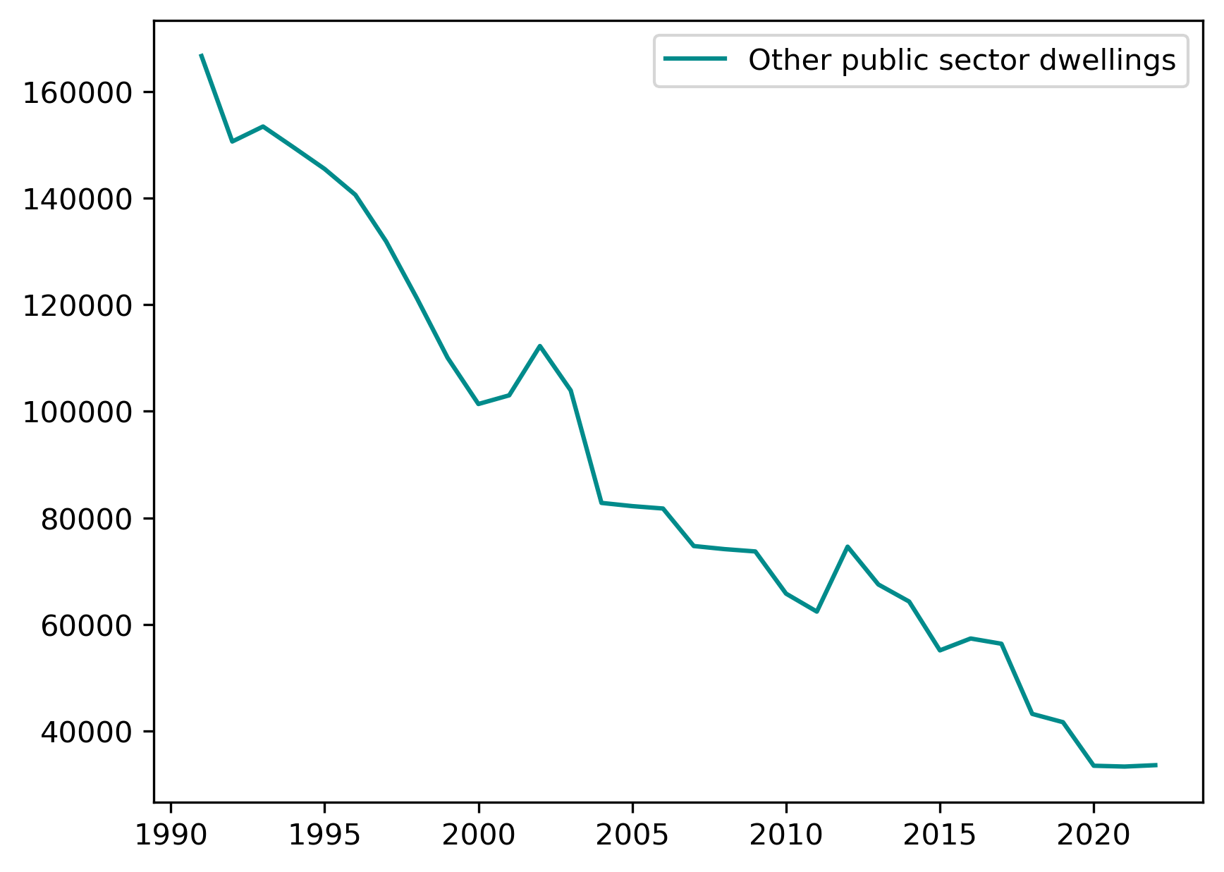
Dwelling by tenure

Slide 11
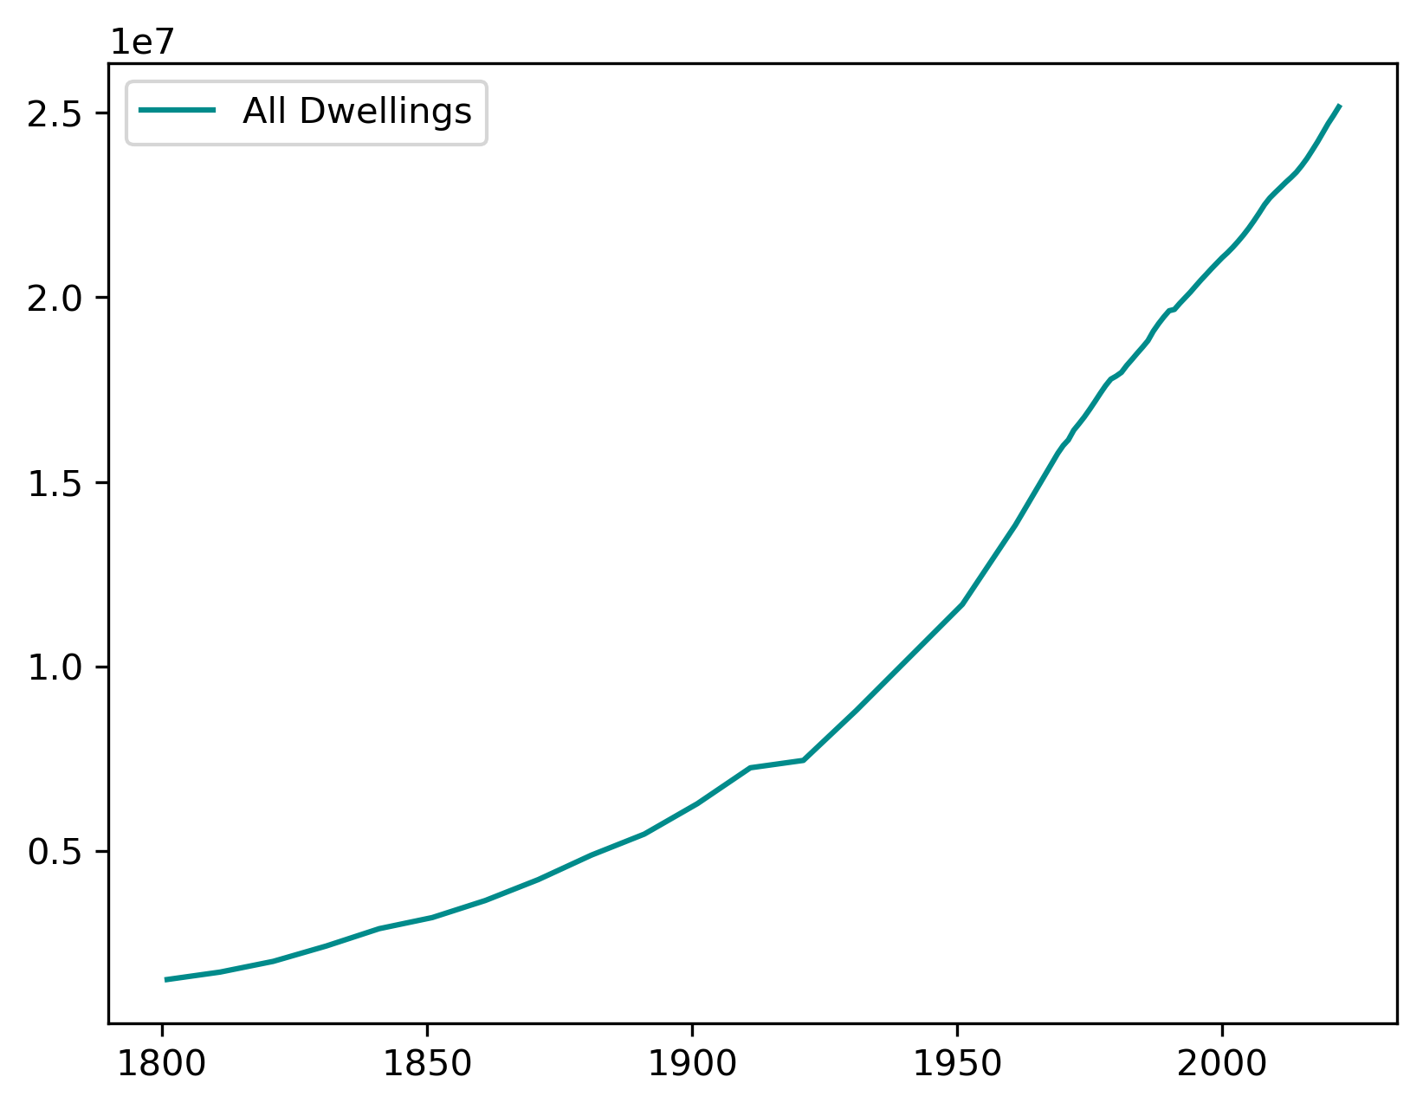

Slide 12
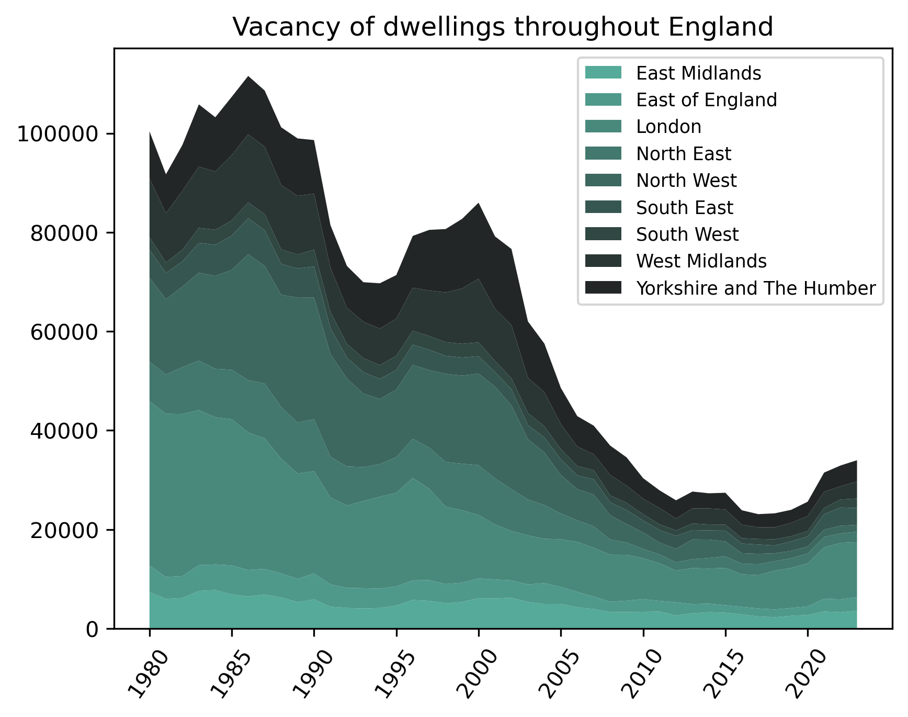

Slide 13
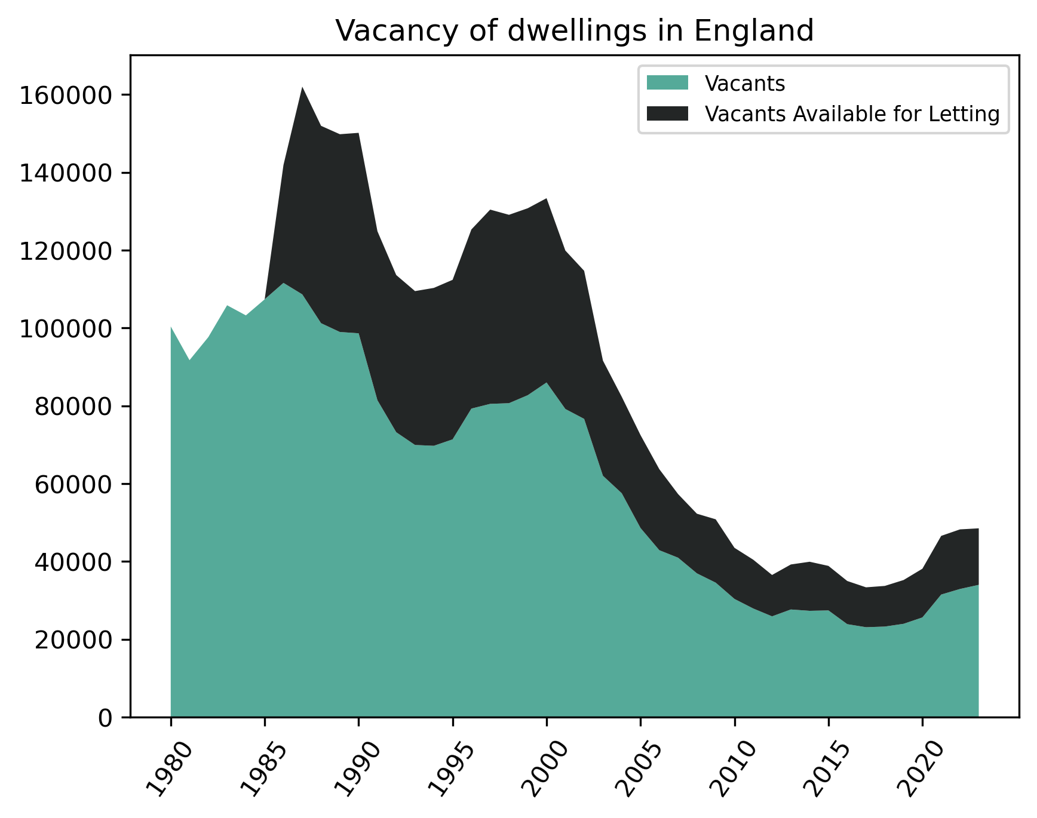
*missing # for availability between 1980 and 1985

Slide 14
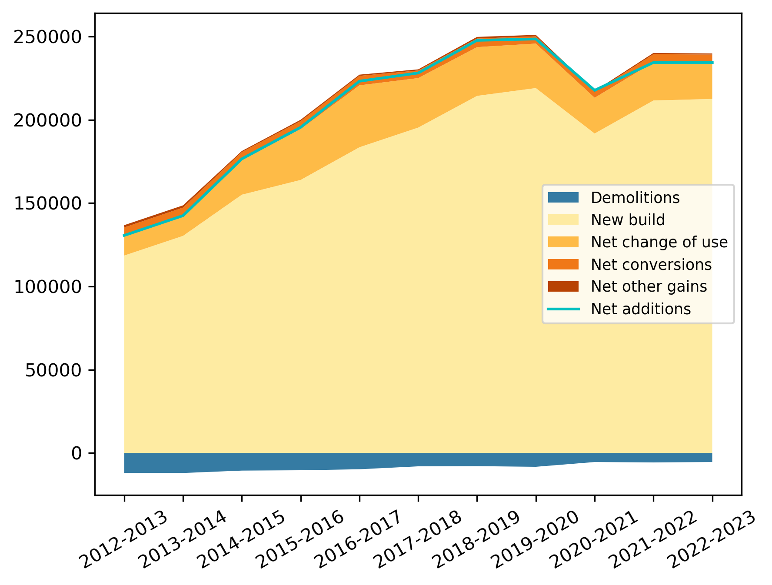

Slide 15
Energy use
ENERGY CONSUMPTION EVOLUTION
ENERGY EFFICIENCY

Slide 16
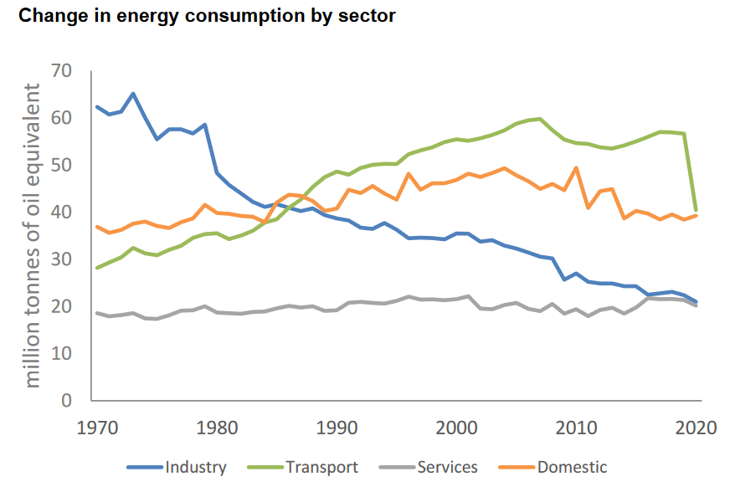
England energy CONSUMPTION

Slide 17
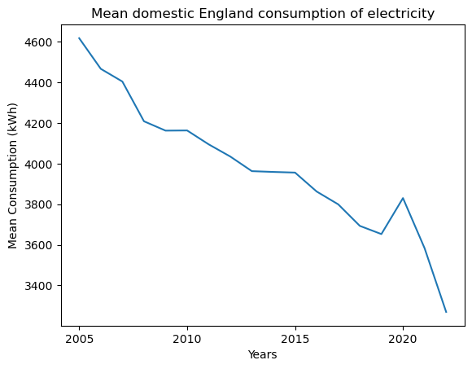
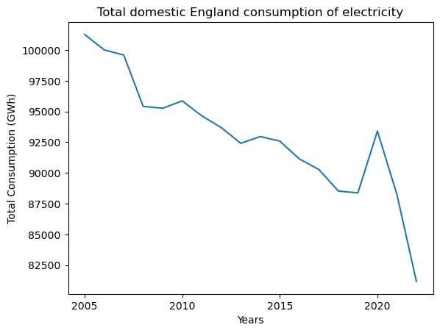
ELECTRICITY DOMESTIC CONSUMPTION

Slide 18
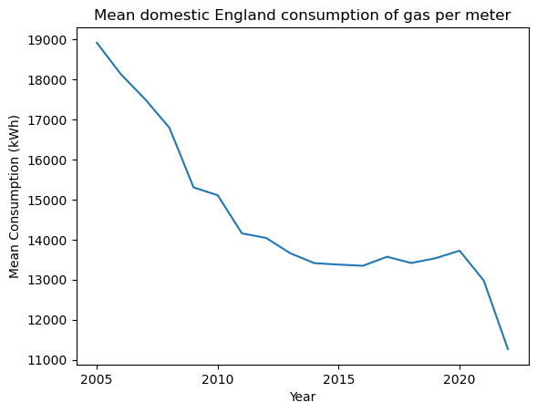
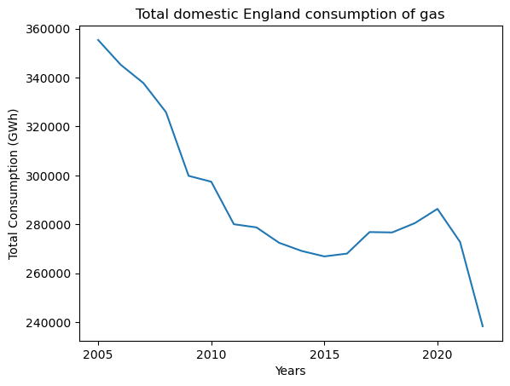
GAS DOMESTIC CONSUMPTION

Slide 19
EXPLAINATION of the decrease of the consumption
Improvement in energy efficiency
Price increased
Government and EU policies

Slide 20
Other expected results
Oil energy consumption
Evolution of energy efficiency

Slide 21

METHODS
Past (1801-2022)
& Future

Slide 22
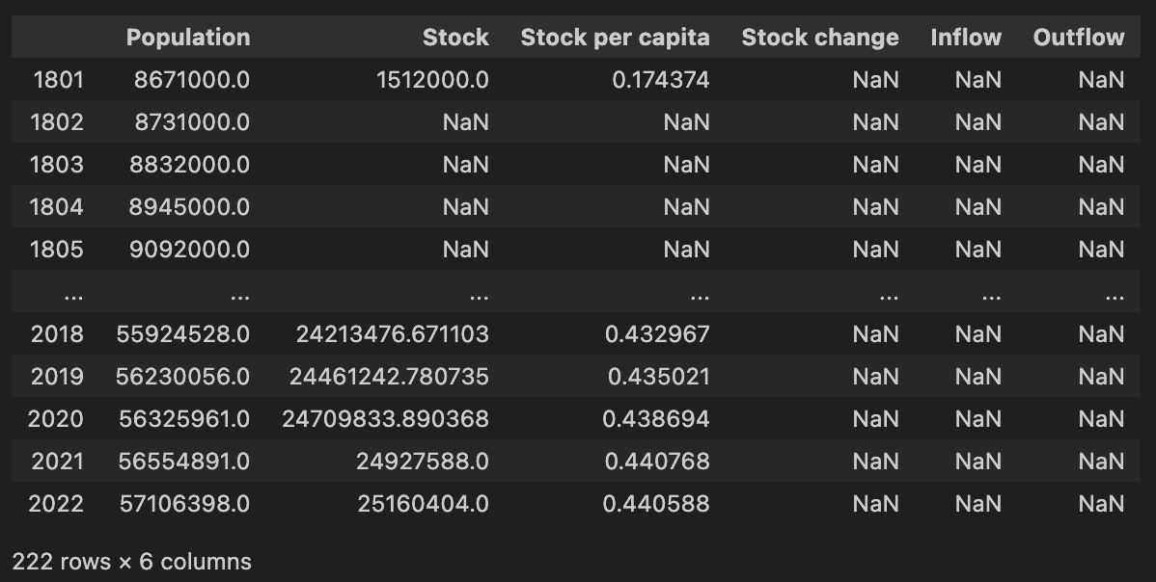
Population and (partial) stock

Slide 23
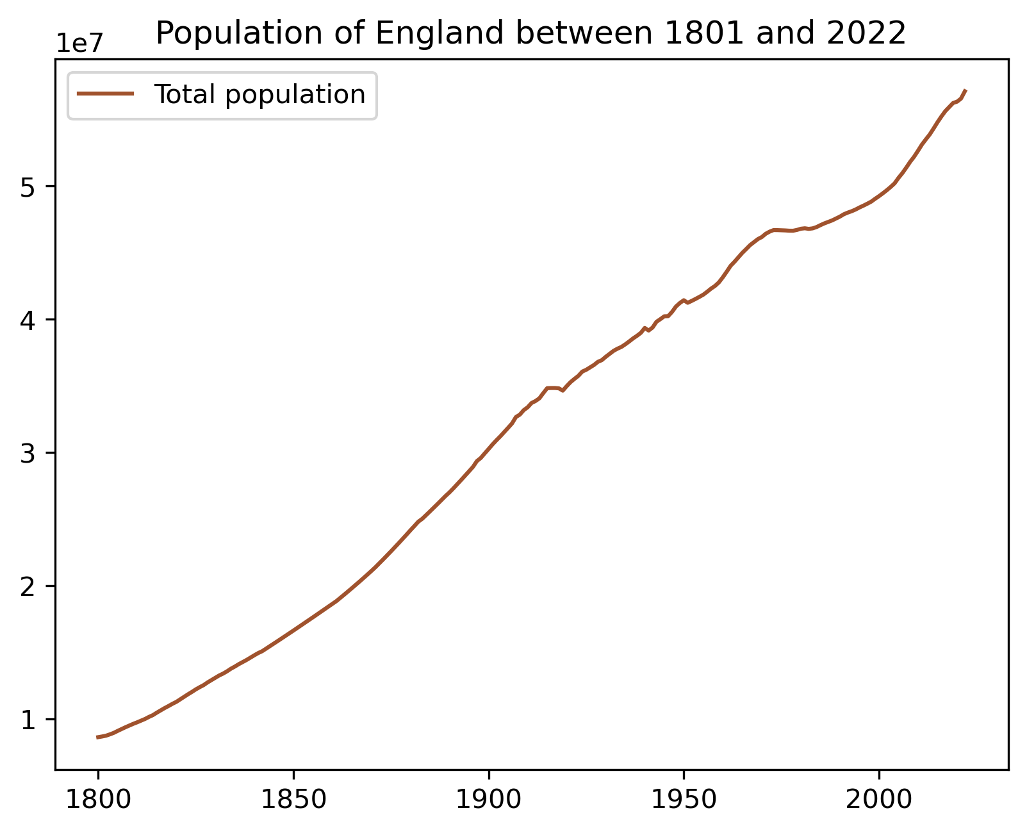
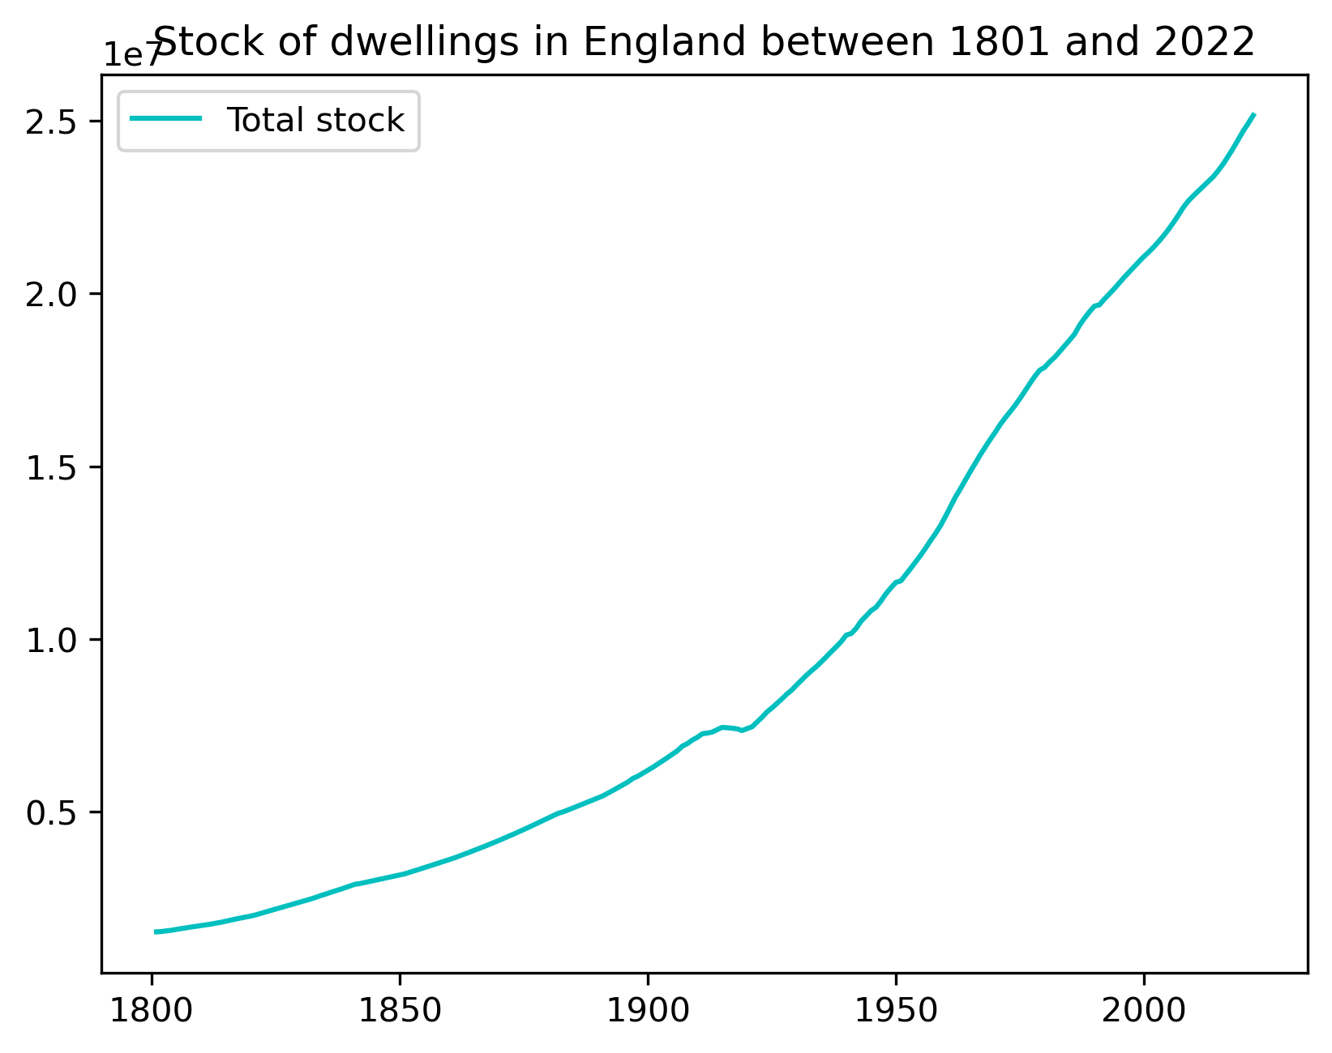
Population and (INTERPOLATED) stock
Interpolation

Slide 24
PAST DATA MODELLING
Interpolation on stock per capita
We have the stock on all the past timeframe
We calculate the stock change for 1802-2022
TBD:
Cohorts by year and type: find data concerning dwelling types
Find the right lifetime (by cohort) for fitting and regression

Slide 25
FUTURE DATA MODELLING
TBD:
Integrate population projections from the ONS
Integrate the vacancy tendencies
Integrate demolition / net change of use + conversion tendencies
+ Look into plan for eventual new energy regulations

Slide 26
Thank you
Emrys Duclos
Tiffany Tran-Heinerich

